Slide 1
Project Proposal Group-4 Aman Mishra Anant Panthri Neha Singh Sonakshi Mishra Soneti Moore

Slide 2
Data Study
The group has unanimously decided to use the firsthand dataset of an Indian e-Commerce firm Flipkart Internet Pvt. Ltd.
The dataset relates to the recruitment process at Flipkart where the candidates are rejected during the application screening process at various stages.

Slide 3
About Flipkart
Flipkart is an e-commerce company founded in India. The company is registered in Singapore, but has its headquarters in Bangalore, India. Flipkart was founded in 2007 by Sachin Bansal and Binny Bansal, both alumni of the Indian Institute of Technology Delhi. They worked for Amazon.com, and left to create their new company incorporated in October 2007 as Flipkart Online Services Pvt. Ltd

Slide 4
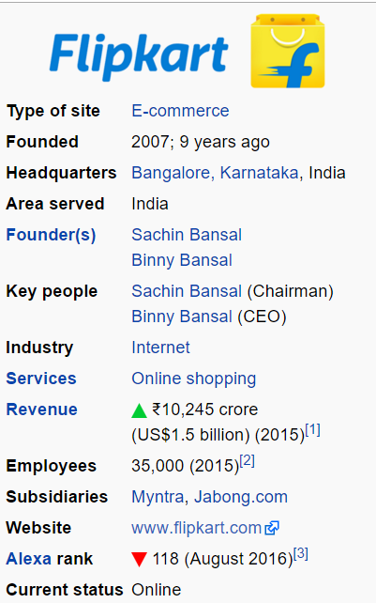

Slide 5
Recruitment @ Flipkart
Flipkart has a very stringent process for recruitment and hiring, it screens candidates through several levels of stages before making a successful offer.
Various Sources are taken into consideration before the application is even taken for screening. Sources like Previous work-ex, University and skill sets for requisite job openings are primary factors that are considered.

Slide 6
What Analysis are we going to do??
After looking at the dataset, the various stages involved during recruitment, Our team intends to do an analysis on candidates whose applications are getting rejected at the various stages of the recruitment process. For example, suppose if 100 applications come up for a job opening, the rejections that are there at different stages are determined and prediction is made upon different variables which enhance a candidates chances of clearing a stage. Variables like previous job experience in particular of any specific previous company is getting preference can be another outcome subset of this analysis. Sources like Linkedin or other job sites like githubs (if a candidate is hired, the most likely source) can also be analyzed through this project

Slide 7
The various stages during recruitment:
The file includes different stages where a candidates is rejected.

Slide 8
Source of Data
A dataset has been shared by an HR from the company on request to do an analysis on the recruitment process.
Since it includes the application details of candidates who are rejected it’s not a primary data of the flipkart employees and hence was agreed to be shared by the HR on a telcon.

Slide 9
THANK YOU

